Slide 1
Final Project: Data Analysis
Anissa Mohd Reza

Slide 2
Investigation: What types of Ps4 games are most popular around the world?
The areas in specific includes North America, Europe, Japan and the rest of the world. The first three areas are the areas with the highest number of video game consumers and every other place was not enough to categorize them independently.

Slide 3
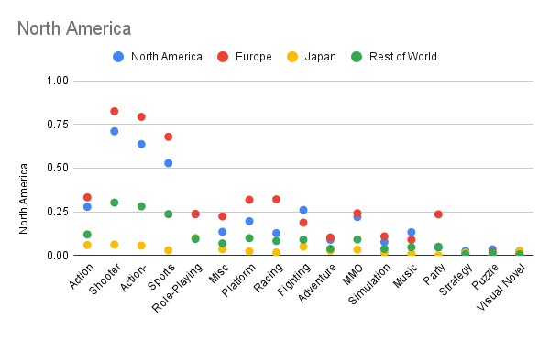
This graph is organized by which area is which colored dot with sales on the x-axis and genre of video game on the y-axis​

Slide 4
Process: The problem and the data
Video games are one of the biggest sellers for entertainment, so how do these companies know where to advertise for certain games?
I used Kaggle.com to find data sets based off the best video games sales and the genre of video game

Slide 5
Analysis Conducted
Europe and North America had the largest increase of sales of shooter, action-adventure, and sports games. Japan has the same number of sales for each type of genre of video because of how diverse Japanese video game companies' market.
Japanese video game companies like Nintendo do not have one specific type of game and try to make diverse topics which could explain why there is no jump in data for them.

Slide 6
Analysis Conducted pt. 2
For Europe, racing games and platform games have a slight bump in data compared to all other areas in the data set. Racing is popular in European countries because of the rise of F1 racing which could explain the small spike.
North America has small jumps for action games and fighting games. With the rise of streaming, many streamers tend to play multiplayer fighting games with their friends for content which can explain the bump.

Slide 7
Results
Shooter, Action-Adventure, and Sports were the top of the charts with games like Call Of Duty and Grand Theft Auto at the top; the most popular games.
These areas heavily influence the type of popular video games because of what might be happening around them i.e., F1 Racing in Europe.

